Slide 3
electric field kernel
sawtooth
regularized

Slide 4
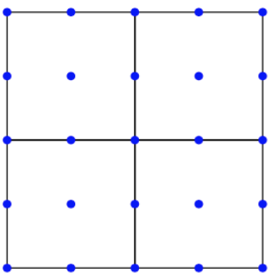
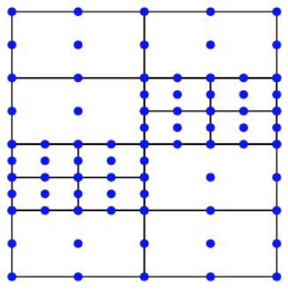
uniform panels
adaptively refined

Slide 6
example 1 : weak Landau damping
L2-norm of electric field

Slide 7
example 1 : weak Landau damping
electron pdf in phase space , deviation from Maxwellian
t = 0
t = 0
t = 5
t = 10
t = 20
t = 60

Slide 8
example 1 : weak Landau damping
slices through deviation from Maxwellian at x=0

Slide 9
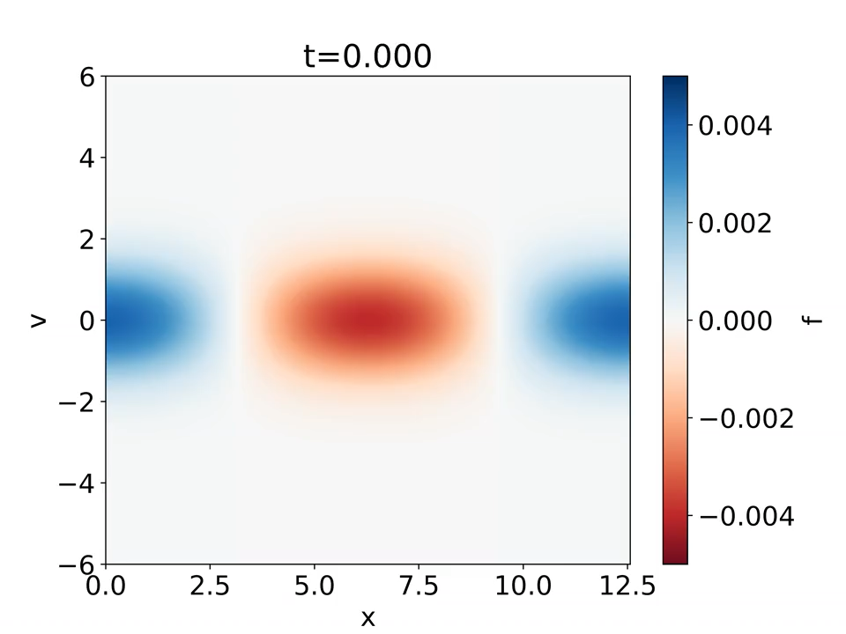
example 1 : weak Landau damping + time reversal

Slide 10
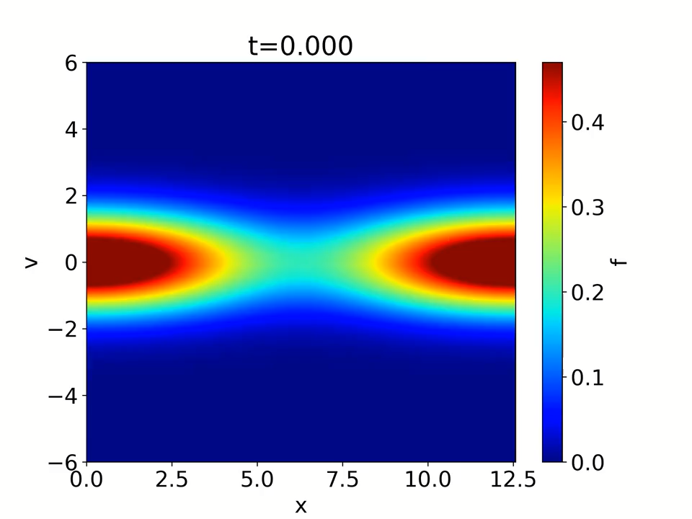
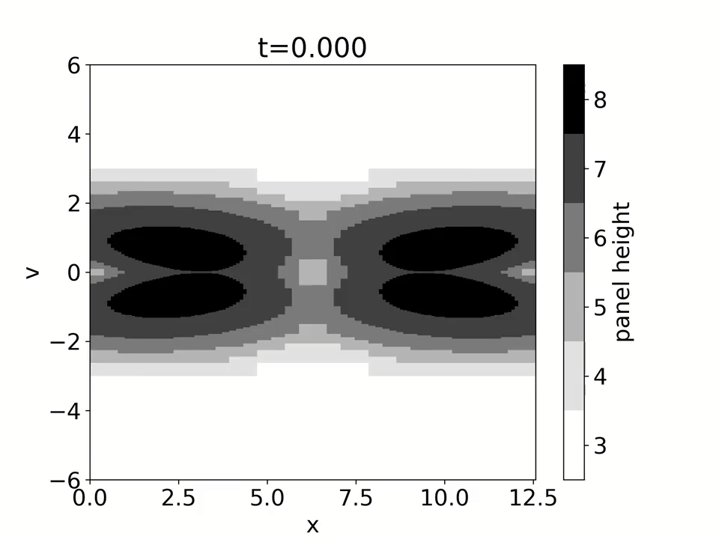
example 2 : strong Landau damping
electron pdf in phase space
adaptively refined panels

Slide 11
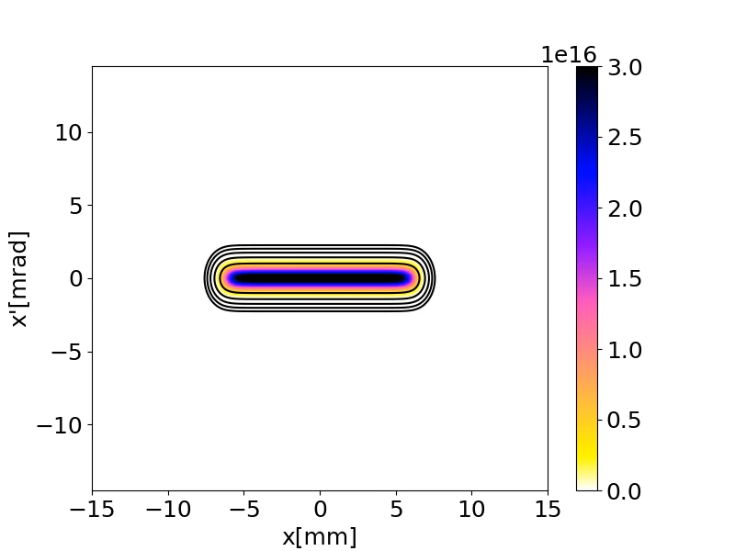
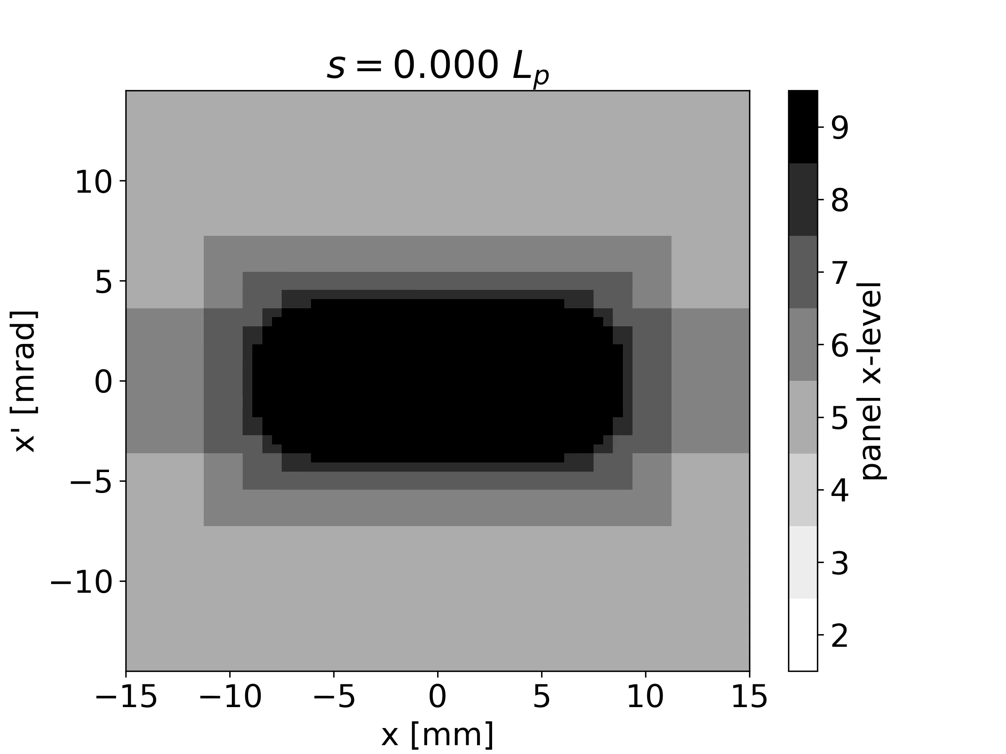
example 3 : ion beam in a focusing channel

Slide 12
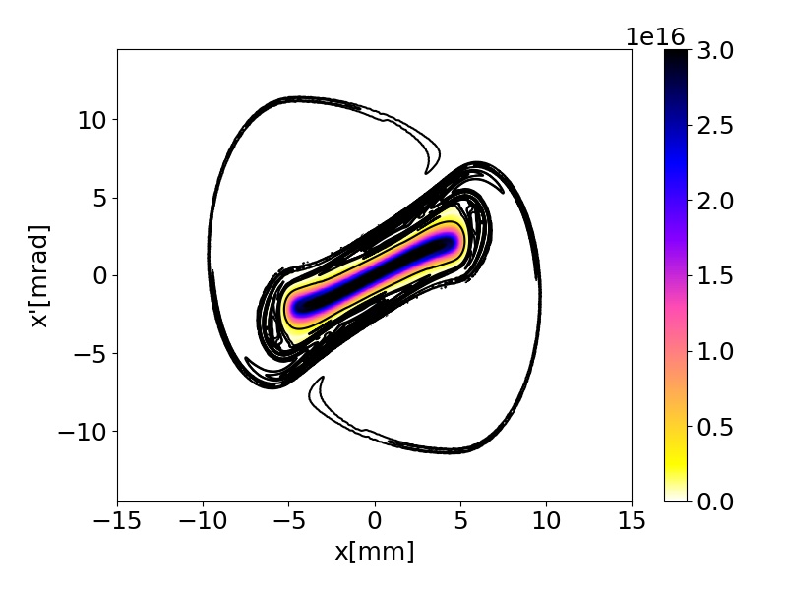

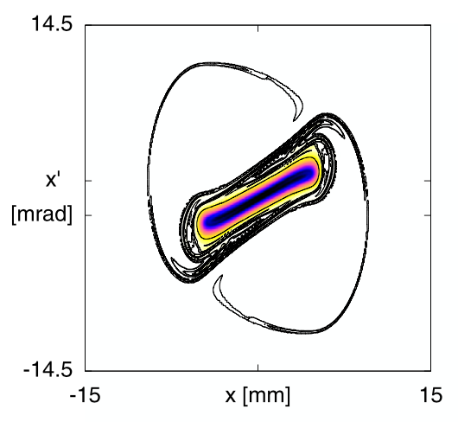
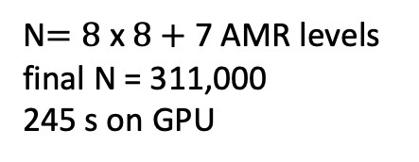
example 3 : ion beam in a focusing channel
N$=\text{8 }\text{x} \text{8}+$7 AMR levels
final N = 311,000
245 s on GPU
uniform
N = 1024 x 1024
1042 s on GPU
LTPIC
Campos Pinto et al 2014
N = 512 x 512
Notes:
On this slide we compare halo formation with AMR, without, and with the Campos Pinto et al. reference solution. The phase spaces are only slightly different. The AMR simulation took ¼ of the time of the uniform simulation. We achieve similar results to the published reference solution for comparable resolutions – about the same timestep and about the same spatial resolution (LTPIC : particles have velocity width given by 4 degrees of freedom; our panels have 4 points)

Slide 13



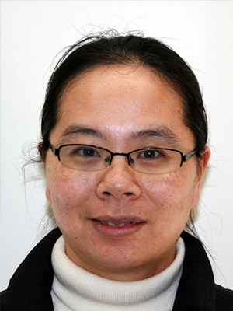



collaborators
Ryan Sandberg
Alexander Thomas
Ling Xu
Lei Wang
Svetlana Tlupova
Nathan Vaughn
Leighton Wilson

